Slide 1

Fire Detection & extinguishing system
Presented By :- group-1c42020
Guided By :- prof. Aparna Chavan
Subject :- Project Based learning (PBL)

Slide 2
Project id :- 1c42020
Group Members :-
1) Suyash More (10453) 2) Utkarsh Magar (10463) 3) Diptesh Varule (10467) 4) Sahil Date(10455) 5) Abhijeet Mahajan (10461) 6) Nidhi Kowtal (10464) 7) Nishad Kulkarni (10457)

Slide 3
Introduction
Nowadays we encounter with the fires generated at various places such as home, offices, schools, etc. Such fires ,which may occur due to short circuits, causes damage to various appliances as well as leads to damage to the property.
So, it is essential to develop automated systems which would help us to detect the fires and help us to extinguish that fire. Hence our project is based on “FIRE DETECTION AND EXTINGUISHING SYSTEMS”. We have designed an electronic circuit including an Arduino UNO .
The circuit consists of the temperature sensor LM 35 which detects the fire generated .We have a program written in Arduino UNO which cuts the electrical supply of the home once the fire is encountered and activates a water pump to extinguish fire.

Slide 4
Why we need fire extinguishers ?
Fire extinguishers are extremely important as they are the most commonly used for of fire protection. In many cases they are a first line of defense and often contain or extinguish a fire, preventing costly damage.
Stay safe by having a fire extinguisher handy !!!

Slide 5
HISTORY behind fire extinguisher’s
By the late 1800’s, the electric fire alarm system was invented. This was the first time a thermostat could detect heat and trigger the sprinkler system to displace a fire.

Slide 6
TECHNOLOGICAL ADVANCEMENTS IN FIRE ALARMS
So what about the fire alarm system today? What new and innovative ways are fire alarm systems protecting people and buildings?
Today, the newest development of the fire alarm system has been the addressable head.

Slide 7


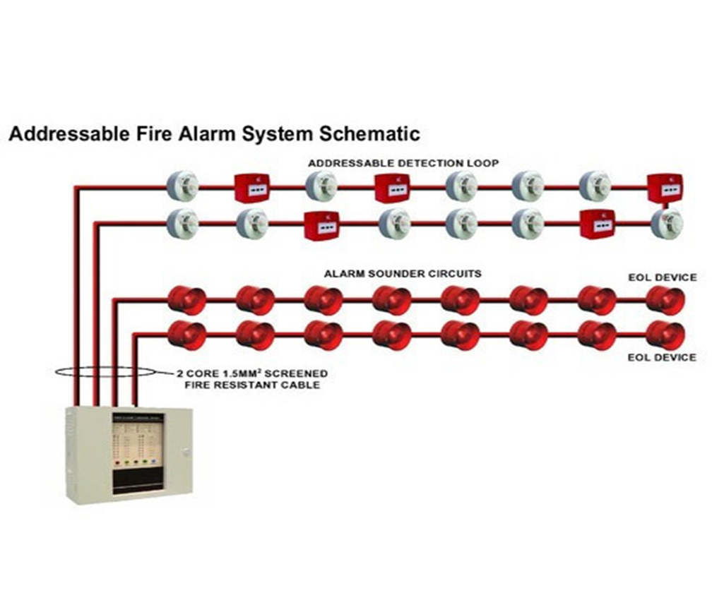
ADDRESSABLE FIRE ALARM SYSTEM
Before the addressable head, there was an alphanumeric display at the control panel that indicated what zone was being affected. With the addressable head, the location can be pinpointed directly at the control panel.

Slide 8
Our objective
The main objective of our project is to detect fire or electric mishap at our homes using temperature sensors, and then extinguish the fire using water. In the meantime, the module starts spreading water and over fire lit area.

Slide 9
About Arduino uno (r3)
The main functioning of the project is based on the controller called as ARDUINO UNO R3. It is used in many IOT projects. So, the brain behind this is the controller. The peripherals attached to the controller are LED, Water supply unit and LM35 temperature sensor.

Slide 10
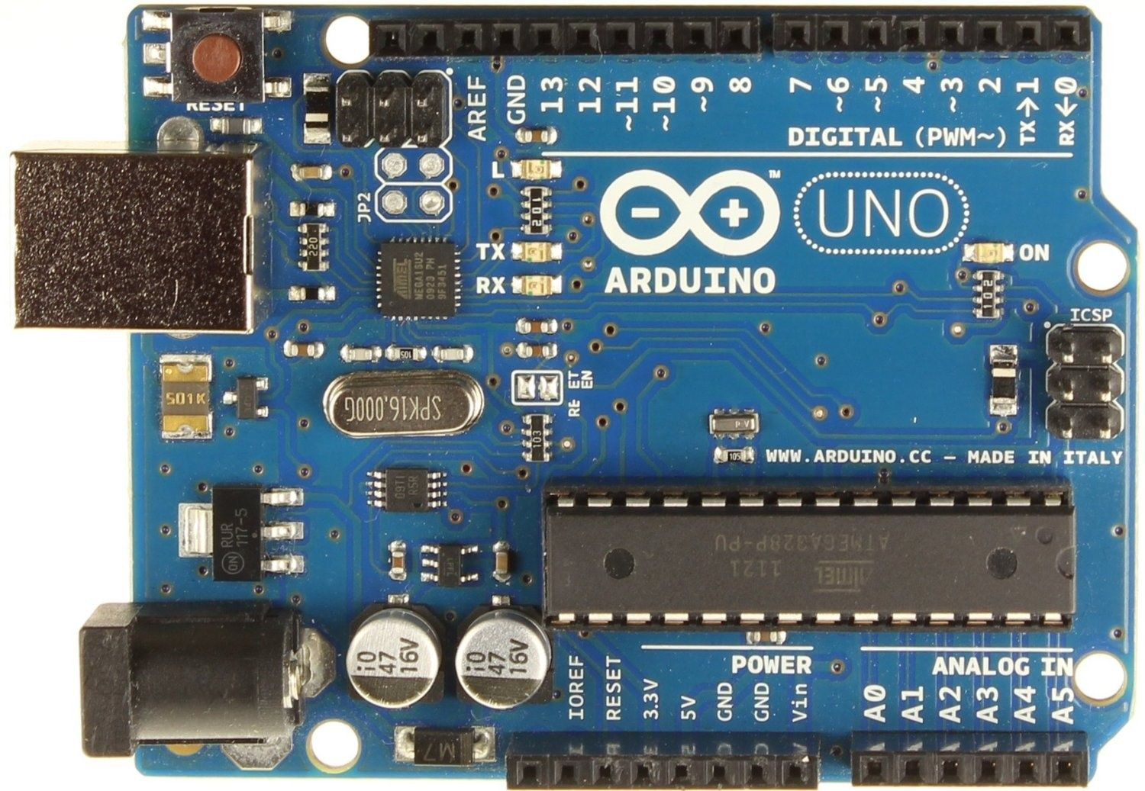

Slide 11
Arduino uno (Technical Specification)
Parameter
detail
Microcontroller
Operating Voltage
Recommended Input Voltage
Input Voltage Limits
Analog Input Pins
Digital I/O Pins
ATmega328P – 8 bit AVR family microcontroller
5V
7-12V
6-20V
6 (A0 – A5)
14 (Out of which 6 provide PWM output)

Slide 12
Arduino uno (Technical Specification)
Parameter
detail
DC Current on I/O Pins
DC Current on 3.3V Pin
Flash Memory
SRAM
EEPROM
Frequency (Clock Speed)
40 mA
50 mA
32 KB (0.5 KB is used for Bootloader)
2 KB
1 KB
16 MHz

Slide 13
About lm35 (temperature sensor)
The circuit can be built with an LM35 temperature sensor.
The main function of this sensor is to sense the exact centigrade temperature.
The circuit can be designed to activate or deactivate a device at a specific edge temperature.
The temperature can be indicated by using two LEDs namely green LED.

Slide 14
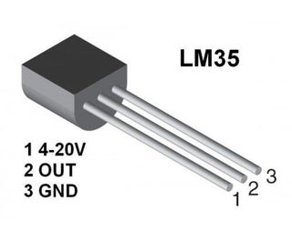

Slide 15
Use of ic741
Unlike the thermistor, precision IC sensors linearity is very good accuracy at 0.5°C and has an ample range of temperatures.
The o/p of this is comparative to the Celsius temperature.
The temperature operating range of this IC ranges from -55° to +150°C.
It draws only above 50 μA from its supply and the main features are self-heating and < 0.1 degrees centigrade in the air.
This IC operating voltage ranges from 4volts to 30volts, and the o/p is 10mv°C.

Slide 16


Slide 17
Circuit implementation using op-amp
The secondary IC o/p enlarges in proportion to the temperature by 10 mV/°.
This changing voltage is supply to an IC 741 OP Amplifier. These are extensively used integrated circuits.
This circuit uses a 741 op-amp as a non-inverting amplifier which means the input pin is pin-3, and the o/p pin is inverted.
This circuit increases the variation between its input terminals.

Slide 18
construction
This system consists of a LM35 temperature sensor, relay circuits, LCD, the microcontroller and water pump system. So basically, this whole system is related to the whole electronics based project which is useful in daily life aspects.

Slide 19
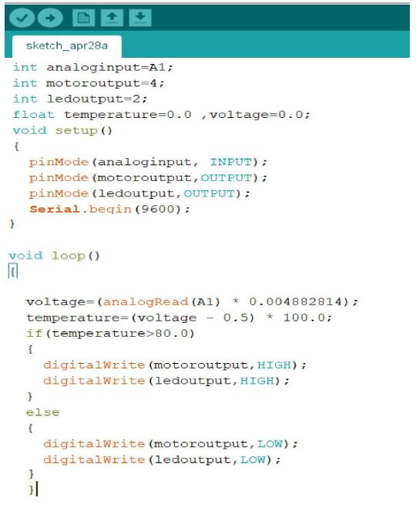
the Code feed to Arduino uno (r3) is…

Slide 20
How it works …
The temperature is taken as input from the sensor to the controller.
The value for a normal room temperature is been set in the controller.
As the temperature taken input from the sensor exceeds the given value of the normal room temperature the water supply system is started, and the LED goes on due to high temperature.
Again, when the temperature is lowered due to the water supply to the fire lit area, the temperature falls below the room temperature the water supply and the LED goes off indicating the temperature is below the room temperature.

Slide 21
Awareness about fire extinguisher’s
The safe operation of fire extinguishers is your first line of defense in protecting your people and property in the event of a fire.
Fires start small and may be extinguished by well-trained, knowledgeable employees using the proper equipment.
But that’s not possible for all families out there so there should be awareness about these various extinguishing systems, here we tried a small project and its gone work fine.
So that should be spread because the cost of it is less and can be put on work in many houses at low cost.

Slide 22
SAFETY MEASURES IN FIRE ALARM SYSTEMS
Provide adequate means of escape.
Outline clear pathways to exit doors.
Install smoke detection systems.
Conduct regular fire drills.
Use flame-retardant materials in interiors.

Slide 23
Automatic Fire Extinguishers are designed to combat fires in transport, such as in the engine compartments of boats or large vehicles, or in industrial use, such as in generator or computer rooms.
Advantages include easy recharging and lack of constant monitoring, and removal of the need for manual operation in unmanned areas.
They cost from £30 to £85 for smaller models; complete systems can cost from £500 to £1,750.

Slide 24
If Fire is caused due to Wood, Paper & Textile then we can use Water and Foam Extinguishers.
If Fire is caused because of flammable liquids such as petrol, diesel, etc. then we can use foam and carbon dioxide type Extinguishers.
If Fire is caused due to short-circuit i.e electrical contact the we can use carbon dioxide type fire extinguishers.

Slide 25
Forest fires
Protecting lives of people which lives in fire.
Protecting Residency Property.
Protecting Forest Resources.
Protecting Lives of Fire Fighters.
Preventing Air Pollution.
Preventing Wild Animals.

Slide 26
Enlarging our perspective's
Using Different Types of Arduino’s.
Using Various Shields.
Using AI & IOT.
Reusing Resources.

Slide 27
Final Thoughts…
This Project FIRE DETECTION & EXTINGUSHING SYSTEM is used in household and industrial area where the chances of getting fire is high.
Thus, we can minimize the Economical and Human loss.

Slide 28


